Slide 1

Pointers
SCSJ1023 Programming Technique II
SEM2 2013/2014
Weeks 6 & 7
Source from Tony Gaddis, Starting out with C++,
7th edition update. Pearson

Slide 2
9.2
Pointer Variables

Slide 3

Addresses and Pointers
Address:
  A uniquely defined memory location which is assigned to a variable.
  Example - a positive integer value
<An analogy with post box>
Post office box number individual name contents
78 John Ruiz catalog
Memory Address identifier contents
66572 x 105

Slide 4
Notation for memory snapshot
Memory Address identifier contents
66572 x 105
memory
address
66572
contents
105
x
identifier

Slide 5
Getting the Address of a Variable
Each variable in program is stored at a unique address
Use address operator & to get address of a variable:
  int num = -99;
  cout << &num; // prints address
  // in hexadecimal

Slide 6
Example 1
#include <iostream>
using namespace std;
int main()
{
int x=25;
cout<<"The address of x is= "<<&x<<endl;
cout<<"The value in x is "<< x<<endl;
}

Slide 7
Results of Example 1
x
25
The address of x is 0x8f05
The value in x is 25;

Slide 8
Exercise Weeks 6/7_1
Type & execute the following program
Check with your friend the address displayed.
#include <iostream>
using namespace std;
int main()
{
int x=25;
cout<<"The address of x is= "<<&x<<endl;
cout<<"The value in x is "<< x<<endl;
}

Slide 9
Pointer Variables
Pointer variable : Often just called a pointer, it's a variable that holds an address
Because a pointer variable holds the address of another piece of data, it "points" to the data
Pointer variables are yet another way using a memory address to work with a piece of data.
This means you are responsible for finding the address you want to store in the pointer and correctly using it.

Slide 10
Pointer Variables (cont.)
Definition:
  int *intptr;
Read as:
“intptr can hold the address of an int”
Spacing in definition does not matter:
  int * intptr; // same as above
  int* intptr; // same as above

Slide 11
Pointer Variables (cont.)
Assigning an address to a pointer variable:
  int *intptr;
  intptr = &num;
Memory layout:
num
intptr
25
0x4a00
address of num: 0x4a00

Slide 12
Pointer Variables (cont.)
int a, b, *ptr ;
ptr = &a
or
int a, b, *ptr = &a ;
ptr
a
0
b
0

Slide 13
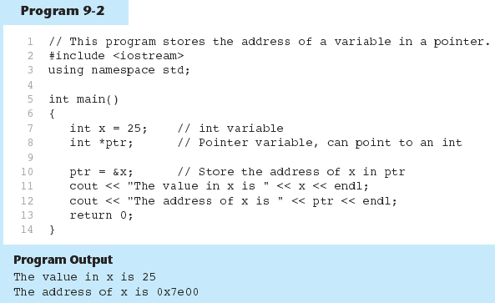
Pointer Variables - example

Slide 14
The Indirection Operator
The indirection operator (*) dereferences a pointer.
It allows you to access the item that the pointer points to.
int x = 25;
int *intptr = &x;
cout << *intptr << endl;
This prints 25.

Slide 15
Pointer Variables (cont.)
int a = 5, b = 9,
*ptr=&a;
b = *ptr;
ptr
a
5
b
9
ptr
a
5
b
5
b=*ptr : b is assigned the value pointed to by ptr

Slide 16
Pointer Variables (cont.)
ptr
int a = 5, b = 9, *ptr=&a;
*ptr = b;
a
5
b
9
ptr
a
9
b
9
*ptr = b : the value pointed to by ptr is assigned the value in b.

Slide 17
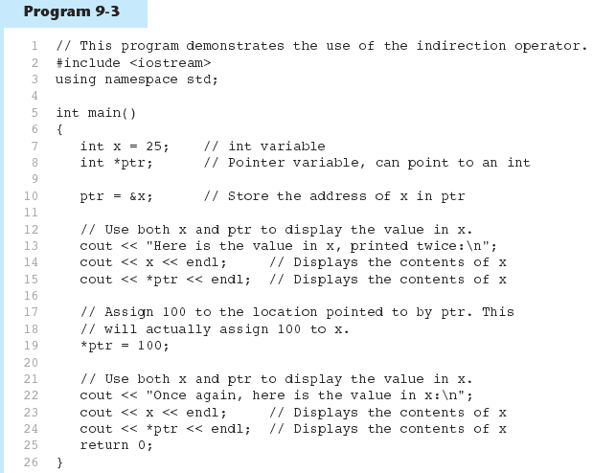
Pointer Variables - example

Slide 18
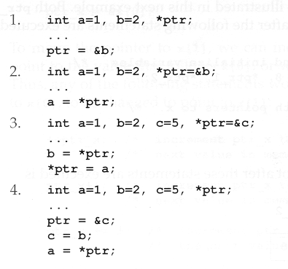
Exercise Weeks 6/7_2
Give memory snapshots after each of these sets of statements are executed.

Slide 19
Exercise Weeks 6/7_3
Refer to Exercise 2 No. 8 in pg. 73.
Solve the problem.

Slide 20
Something Like Pointers: Arrays
We have already worked with something similar to pointers, when we learned to pass arrays as arguments to functions.
For example, suppose we use this statement to pass the array numbers to the showValues function:
showValues(numbers, SIZE);

Slide 21
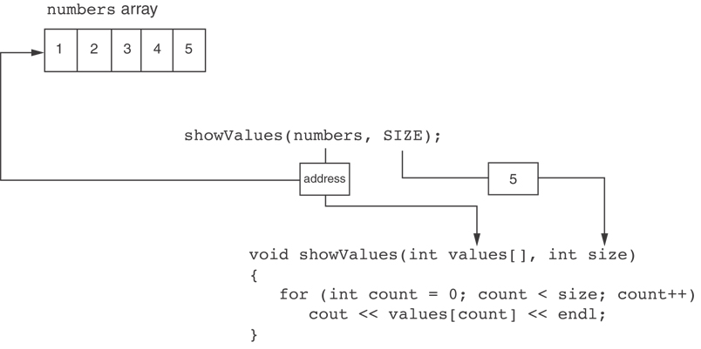
Something Like Pointers : Arrays
The values parameter, in the showValues function, points to the numbers array.
C++ automatically stores the address of numbers in the values parameter.

Slide 22
Something Like Pointers: Reference Variables
We have also worked with something like pointers when we learned to use reference variables. Suppose we have this function:
void getOrder(int &donuts)
{
cout << "How many doughnuts do you want? ";
cin >> donuts;
}
And we call it with this code:
int jellyDonuts;
getOrder(jellyDonuts);

Slide 23
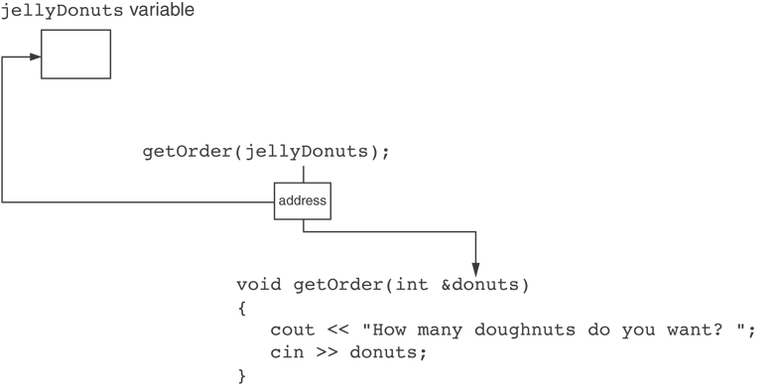
Something Like Pointers: Reference Variables
The donuts parameter, in the getOrder function, points to the jellyDonuts variable.
C++ automatically stores the address of jellyDonuts in the donuts parameter.

Slide 24
9.3
The Relationship Between Arrays and Pointers

Slide 25
The Relationship Between Arrays and Pointers
Array name is starting address of array
  int vals[] = {4, 7, 11};
  starting address of vals: 0x4a00
  cout << vals; // displays 0x4a00
  cout << vals[0]; // displays 4
4 | 7 | 11

Slide 26
The Relationship Between Arrays and Pointers
int x[5], *ptr_x;
ptr_x = &x[0];
ptr_x
memory
allocation
?
?
?
?
?
x[0]
x[1]
x[2]
x[3]
x[4]
The memory location for x[1] is immediately
follow the memory location of x[0]

Slide 27
The Relationship Between Arrays and Pointers (cont.)
Array name can be used as a pointer constant:
  int vals[] = {4, 7, 11};
  cout << *vals; // displays 4
Pointer can be used as an array name:
  int *valptr = vals;
  cout << valptr[1]; // displays 7

Slide 28
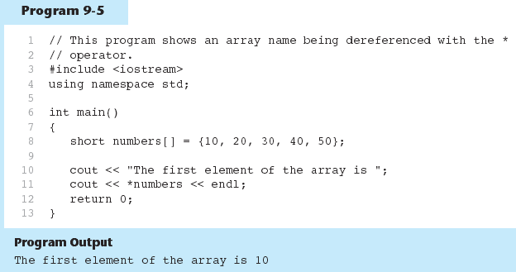
The Relationship Between Arrays and Pointers (example)

Slide 29
Exercise Weeks 6/7_4
Refer to previous program in slide 28 Program 9-5.
Print the third element in the array using pointer number.

Slide 30
9.4
Pointer Arithmetic

Slide 31
Pointer Arithmetic
Operations on pointer variables:
Operation | Example int vals[]={4,7,11}; int *valptr = vals;
++, -- | valptr++; // points at 7 valptr--; // now points at 4
+, - (pointer and int) | cout << *(valptr + 2); // 11
+=, -= (pointer and int) | valptr = vals; // points at 4 valptr += 2; // points at 11
- (pointer from pointer) | cout << valptr–val; // difference //(number of ints) between valptr // and val

Slide 32
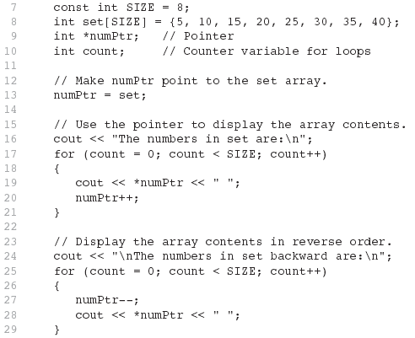
Pointer Arithmetic - Example

Slide 33
Pointers in Expressions
Given:
  int vals[]={4,7,11}, *valptr;
  valptr = vals;
What is valptr + 1? It means (address in valptr) + (1 * size of an int)
  cout << *(valptr+1); //displays 7
  cout << *(valptr+2); //displays 11
Must use ( ) as shown in the expressions

Slide 34
Pointers in Expressions
depends on the machine used
depends on the variable type
For examples,
  Short integers ( 2 byte )
  Floating point values ( 4 byte )
beginning : ptr = 45530
after ptr++ : ptr = 45532
beginning : ptr = 50200
after ptr++ : ptr = 50204

Slide 35
Array Access
Array elements can be accessed in many ways:
Array access method | Example
array name and [] | vals[2] = 17;
pointer to array and [] | valptr[2] = 17;
array name and subscript arithmetic | *(vals + 2) = 17;
pointer to array and subscript arithmetic | *(valptr + 2) = 17;

Slide 36
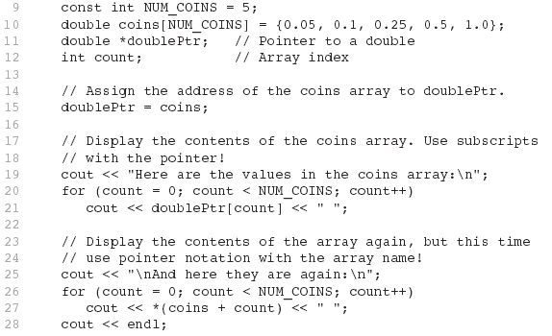
Array Access

Slide 37
Exercise Weeks 6/7_5
Refer to Exercise 2 No. 9 in pg. 73.
Solve the problem.

Slide 38
9.5
Initializing Pointers

Slide 39
Initializing Pointers
Can initialize at definition time:
  int num, *numptr = &num;
  int val[3], *valptr = val;
Cannot mix data types:
  double cost;
  int *ptr = &cost; // won’t work
Can test for an invalid address for ptr with:
  if (!ptr) ...

Slide 40
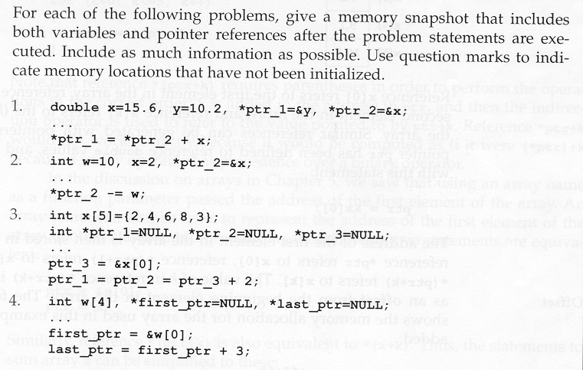
Exercise Weeks 6/7_6
Exercise Week 3_5

Slide 41
9.6
Comparing Pointers

Slide 42
Comparing Pointers
Relational operators (<, >=, etc.) can be used to compare addresses in pointers
Comparing addresses in pointers is not the same as comparing contents pointed at by pointers:
  if (ptr1 == ptr2) // compares
  // addresses
  if (*ptr1 == *ptr2) // compares
  // contents

Slide 43
Exercise Weeks 6/7_7
Refer to Exercise 3 No. 1 in pg. 75.
Solve the problem.

Slide 44
9.7
Pointers as Function Parameters

Slide 45
Pointers as Function Parameters
A pointer can be a parameter
implements call-by-address references
allows to modify the values by statements within a called function
Requires:
  asterisk * on parameter in prototype and heading
  void getNum(int *ptr); // ptr is pointer to int
  asterisk * in body to dereference the pointer
cin >> *ptr;
  address as argument to the function
  getNum(&num); // pass address of num to getNum

Slide 46
Pointers as Function Parameters – Example 1
void swap(int *x, int *y)
{ int temp;
temp = *x;
*x = *y;
*y = temp;
}
int num1 = 2, num2 = -3;
swap(&num1, &num2);

Slide 47
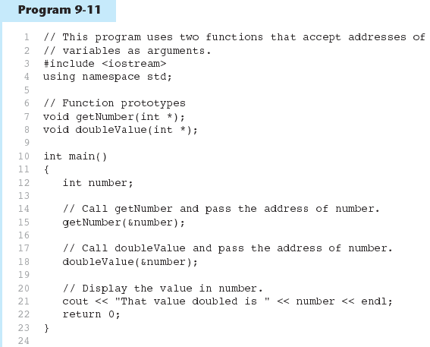
Pointers as Function Parameters – Example 2

Slide 48
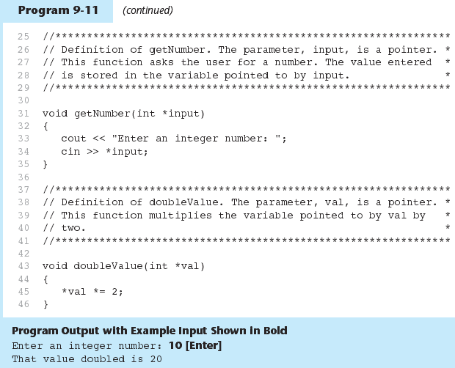
Pointers as Function Parameters – Example 2

Slide 49
Exercise Weeks 6/7_8
Refer to Exercise 3 No. 7 in pg. 79.
Solve the problem.

Slide 50
Pointers to Constants
If we want to store the address of a constant in a pointer, then we need to store it in a pointer-to-const.
Example: Suppose we have the following definitions:
const int SIZE = 6;
const double payRates[SIZE] =
{ 18.55, 17.45, 12.85,
14.97, 10.35, 18.89 };
In this code, payRates is an array of constant doubles.

Slide 51
Pointers to Constants
Suppose we wish to pass the payRates array to a function? Here's an example of how we can do it.
void displayPayRates(const double *rates, int size)
{
for (int count = 0; count < size; count++)
{
cout << "Pay rate for employee " << (count + 1)
<< " is $" << *(rates + count) << endl;
}
}
The parameter, rates, is a pointer to const double.

Slide 52
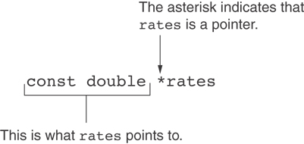
Declaration of a Pointer to Constant

Slide 53
Constant Pointers
A constant pointer is a pointer that is initialized with an address, and cannot point to anything else.
Example
int value = 22;
int * const ptr = &value;

Slide 54
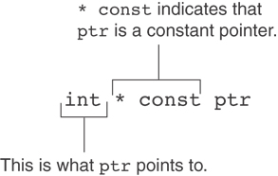
Declaration of a Constant Pointers

Slide 55
Constant Pointers to Constants
A constant pointer to a constant is:
  a pointer that points to a constant
  a pointer that cannot point to anything except what it is pointing to
Example:
int value = 22;
const int * const ptr = &value;

Slide 56
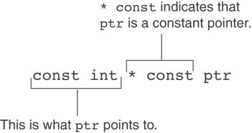
Constant Pointers to Constants

Slide 57
Exercise Weeks 6/7_9
Refer to Exercise 1 No. 6 in pg. 68.
Solve the problem.

Slide 58
9.8
Dynamic Memory Allocation

Slide 59
Dynamic Memory Allocation
Can allocate storage for a variable while program is running
Computer returns address of newly allocated variable
Uses new operator to allocate memory:
  double *dptr;
  dptr = new double;
new returns address of memory location

Slide 60
Dynamic Memory Allocation (cont.)
Can also use new to allocate array:
const int SIZE = 25;
arrayptr = new double[SIZE];
Can then use [] or pointer arithmetic to access array:
  for(i = 0; i < SIZE; i++)
  arrayptr[i] = i * i;
  or
  for(i = 0; i < SIZE; i++)
  *(arrayptr + i) = i * i;
Program will terminate if not enough memory available to allocate

Slide 61
Releasing Dynamic Memory
Use delete to free dynamic memory:
  delete fptr;
Use [] to free dynamic array:
  delete [] arrayptr;
Only use delete with dynamic memory!

Slide 62
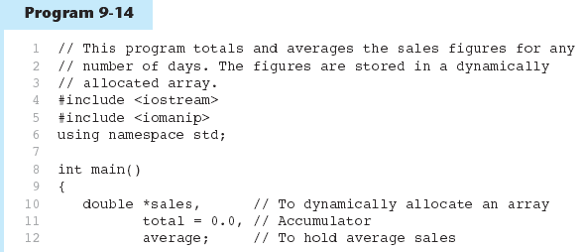
Dynamic Memory - example

Slide 63
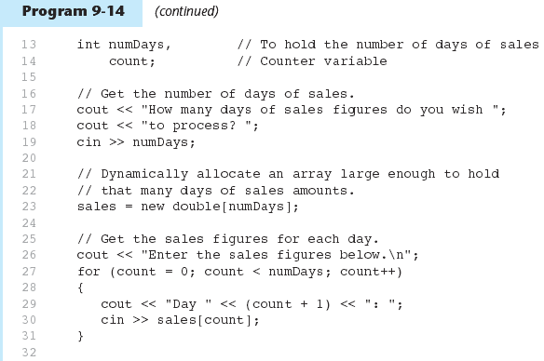
Dynamic Memory - example

Slide 64
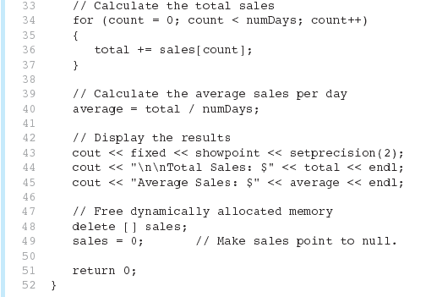
Dynamic Memory - example

Slide 65
Exercise Weeks 6/7_10
Given the following program with 3 errors. Rewrite the program to store the power value of the array’s index and print the values.
int main(){
const int SIZE = 25;
int *arrayptr;
arrayptr = new double[SIZE];
for(int i = 0; i < SIZE; i++)
*arrayptr[i] = i * i;
for(int i = 0; i < SIZE; i++)
cout <<*arrayptr + i<<endl;
return 0;
}

Slide 66
Exercise Weeks 6/7_11
Refer to Exercise 2 No. 10 in pg. 74
Solve the problems.

Slide 67
9.9
Returning Pointers from Functions

Slide 68
Returning Pointers from Functions
Pointer can be the return type of a function:
  int* newNum();
The function must not return a pointer to a local variable in the function.
A function should only return a pointer:
  to data that was passed to the function as an argument, or
  to dynamically allocated memory

Slide 69
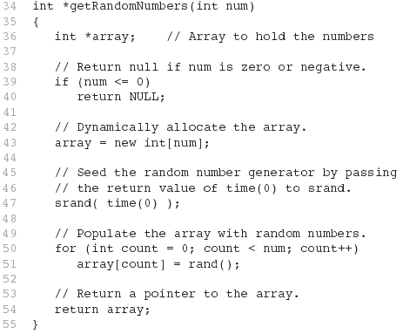
Returning Pointers from Functions - example

Slide 70
Exercise Weeks 6/7_12
Refer to Program5_12.cpp (Ex. 3, No. 3) in page 76
Change the function using the following function prototype:
  int* getStudentID(int studentNum);

Slide 71

Thank You
Q & A

